Slide 1

JNTUH UNIVERSITY COLLEGE OF ENGINEERING SULTHANPUR
Video Synopsis Generator
Batch No: 6
PROJECT GUIDE
22SS1A6606 - B RAJA RAJESHWAR
22SS1A6624 - K SAI MANAS
22SS1A6642 - N SANJAY VARMA
22SS1A6659 - V ABHINAY
Dr .P. Krupa sagar
Assistant Professor
CSE Department

Slide 2
JNTUH UNIVERSITY COLLEGE OF ENGINEERING SULTHANPUR
Table of Contents
I
Abstract
3
II
Introduction
4
III
Existing System
5
IV
Proposed System
5
V
System architecture
7
VI
Explanation
8
VII
Requirements
9
VIII
Design
10
IX
Implementation
14
X
Results
15
XI
Conclusion
17
XII
References
18
2

Slide 3

I
ABSTRACT
This Android-based Video Summarization Application that leverages Natural Language Processing (NLP) and Machine Learning (ML) to generate structured summaries from video content. The application accepts a video file or YouTube link as input, extracts audio using Automatic Speech Recognition (ASR) , and applies advanced NLP techniques to produce outputs such as a detailed description and a concise summary .
3
2

Slide 4

II
INTRODUCTION
Traditional systems require users to manually watch and interpret lengthy videos, making content consumption time-consuming and inefficient. Existing tools may offer basic transcription or keyword extraction but lack structured summarization and real-time processing capabilities.
This project introduces an Android-based Video Summarization Application that overcomes these limitations by leveraging NLP, ML, and ASR. It accepts a video file or YouTube link, transcribes the audio using deep learning models, and generates a detailed description and a concise summary .
4
2

Slide 5

III
EXISTING SYSTEM
Software tools and platforms already exist for video transcription and summarization, such as YouTube auto-captions, Otter.ai, and basic online summarizers. However, these tools often have limitations:
They mainly provide raw transcripts without generating structured summaries.
Summarization accuracy is low, especially for complex or lengthy videos.
Most do not support both extractive and abstractive summarization methods.
They lack real-time or mobile-based processing, reducing accessibility and convenience.
Users often need to use multiple separate tools for transcription and summarization.
5
2

Slide 6

IV
PROPOSED SYSTEM
The proposed system is an Android-based Video Summarization Application that overcomes the limitations of existing tools by integrating Advanced NLP and Machine Learning techniques. It allows users to upload a video file or YouTube link, extracts audio using Automatic Speech Recognition (ASR), and generates:
A detailed description of the video content
A concise summary using both extractive and abstractive summarization
6
2

Slide 7
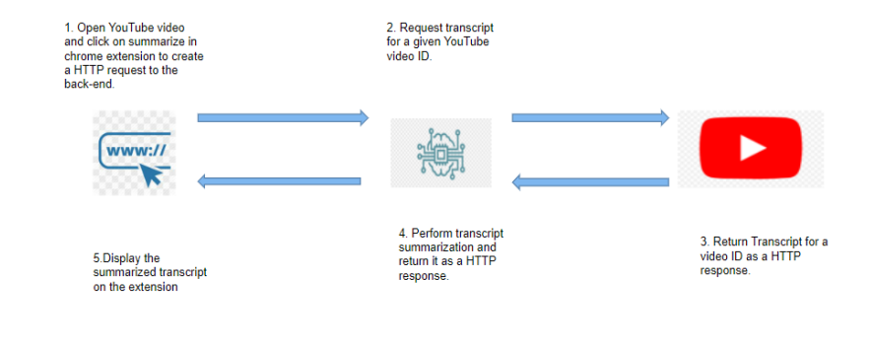

V
SYSTEM ARCHITECTIRE
7
2

Slide 8

VI
EXPLANATION
VSG aims to develop an Android application that automatically generates summaries from videos, using a combination of Natural Language Processing (NLP) and Machine Learning (ML) technologies.
User Input:
The user provides a video file or a YouTube URL through the app.
Audio Extraction:
The app extracts audio from the video using a Video Handler Module.
Speech-to-Text (ASR):
The extracted audio is converted into text using Automatic Speech Recognition (ASR) powered by deep learning models (e.g., Whisper).
Text Summarization:
The transcribed text is processed using NLP techniques to generate:
A detailed description
A concise summary
Output:
The final summary and insights are displayed to the user in a readable format.
8
2

Slide 9

VII
REQUIREMENTS
Software Requirements
Android studio
Flutter
python
Hardware Requiements
Processor: Intel i5/i7
RAM:mininum 8GB
storage: atleast 200 free for app
9
2

Slide 10
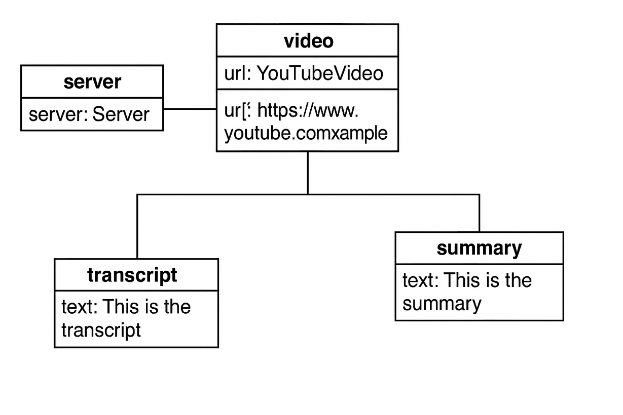
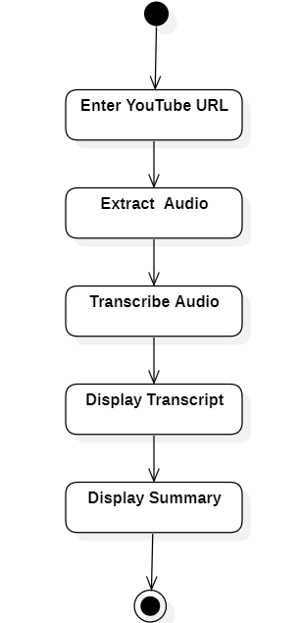
VIII
DESIGN
Class diagram
Activity diagram
10
2

Slide 11
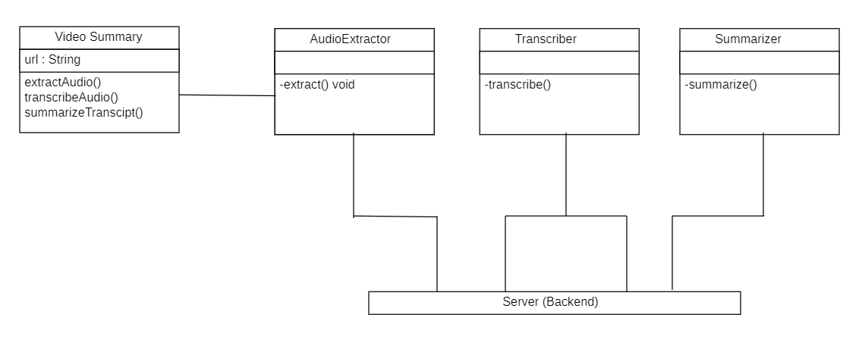
DESIGN
Object diagram
10
2

Slide 12
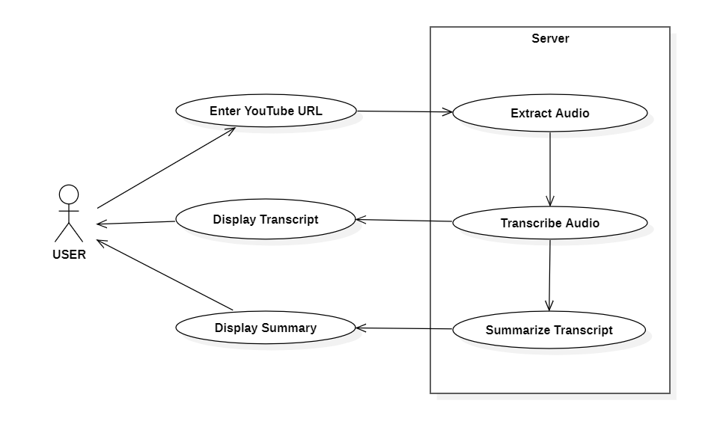
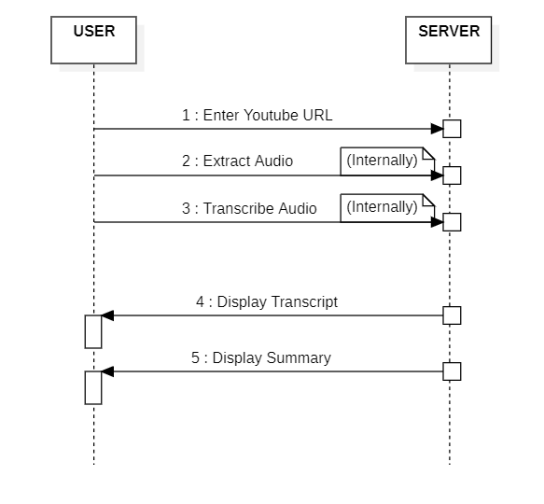
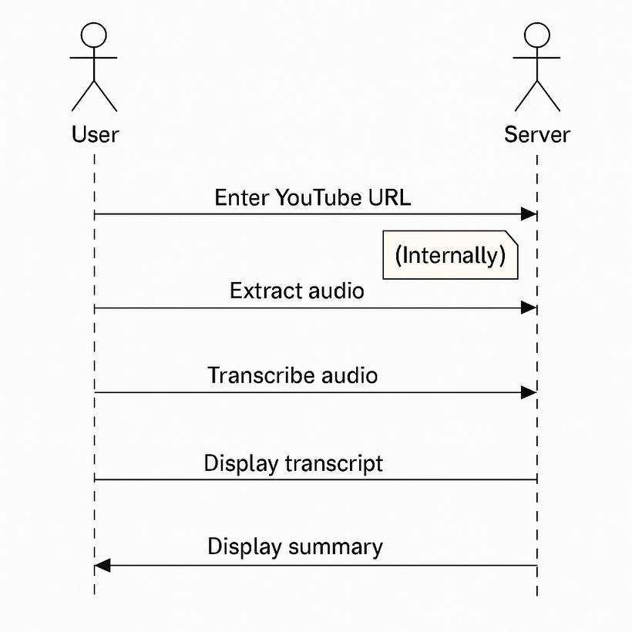
DESIGN
Usecase diagram
Sequence diagram
10
2

Slide 13
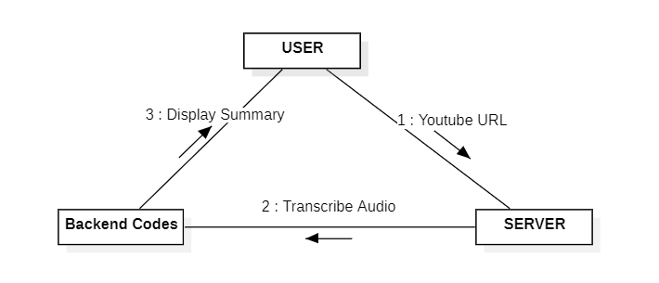
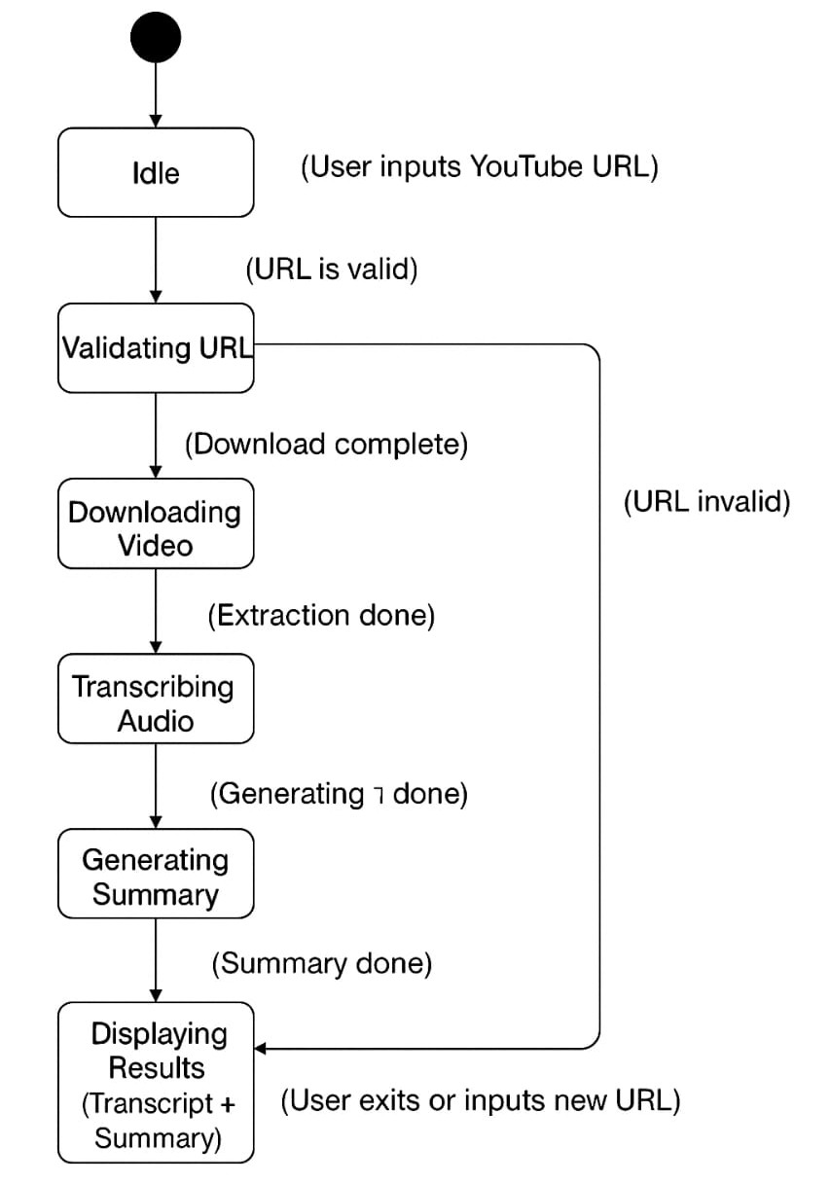
DESIGN
Collaboration diagram
State Chart diagram
10
2

Slide 14
IX
IMPLEMENTATION
Modules Used
Flask
yt_dlp
youtube_transcript_api
transformers
torch
requests
flask-cors
11
2

Slide 15
IX
IMPLEMENTATION
Imported Modules :
from flask import Flask, request, jsonify, send_file
from dataclasses import dataclass
import yt_dlp
from youtube_transcript_api import (
NoTranscriptFound,
TranscriptsDisabled,
YouTubeTranscriptApi,
)
from transformers import pipeline
summarizer = pipeline("summarization", model="sshleifer/distilbart-cnn-12-6")
from flask_cors import CORS
app = Flask(__name__)
CORS(app)
11
2

Slide 16
IX
IMPLEMENTATION
Video extraction :
def extract_Video_information(url: str) -VideoInfo:
ydl_opts = {"quiet": True}
with yt_dlp.YoutubeDL(ydl_opts) as ydl:
info_dict = ydl.extract_info(url, download=False)
return VideoInfo(
id=info_dict.get("id"),
title=info_dict.get("title"),
url=info_dict.get("webpage_url"),
duration=info_dict.get("duration"),
channel=info_dict.get("channel"),
channel_url=info_dict.get("channel_url"),
)
11
2

Slide 17
IX
IMPLEMENTATION
Transcript Code:
def get_transcripts(video_id: str) -> str:
try:
transcript_list = YouTubeTranscriptApi.list_transcripts(video_id)
except TranscriptsDisabled:
return "Transcripts are disabled for this video."
try:
transcript = transcript_list.find_manually_created_transcript(["en"])
except NoTranscriptFound:
try:
transcript = transcript_list.find_generated_transcript(["en"])
except NoTranscriptFound:
return "No English transcript available for this video."
subtitles = transcript.fetch()
if not subtitles:
return "Failed to fetch transcript data or transcript data is empty.“
lines = [sbt.text for sbt in subtitles if sbt.text != "[Music]"]
paragraphs = [" ".join(lines[i:i+4]) for i in range(0, len(lines), 4)]
return “\n ".join(paragraphs)
11
2

Slide 18
IX
IMPLEMENTATION
Summarize Code :
def summarize_text_chunks(text):
summarized_text = []
num_iters = int(len(text) / 1000)
print(f"Summarizing in {num_iters + 1} chunks...")
for i in range(0, num_iters + 1):
chunk = text[i * 1000: (i + 1) * 1000]
if not chunk.strip():
continue
input_length = len(chunk.split())
max_len = min(100, max(20, int(input_length * 0.6)))
min_len = min(30, max(5, int(input_length * 0.3)))
print(f"Chunk {i+1}/{num_iters+1}: summarizing {input_length} words...")
out = summarizer(chunk, min_length=min_len, max_length=max_len)
summarized_text.append(out[0]['summary_text'])
print("Summarization complete.")
return " ".join(summarized_text)
11
2

Slide 19
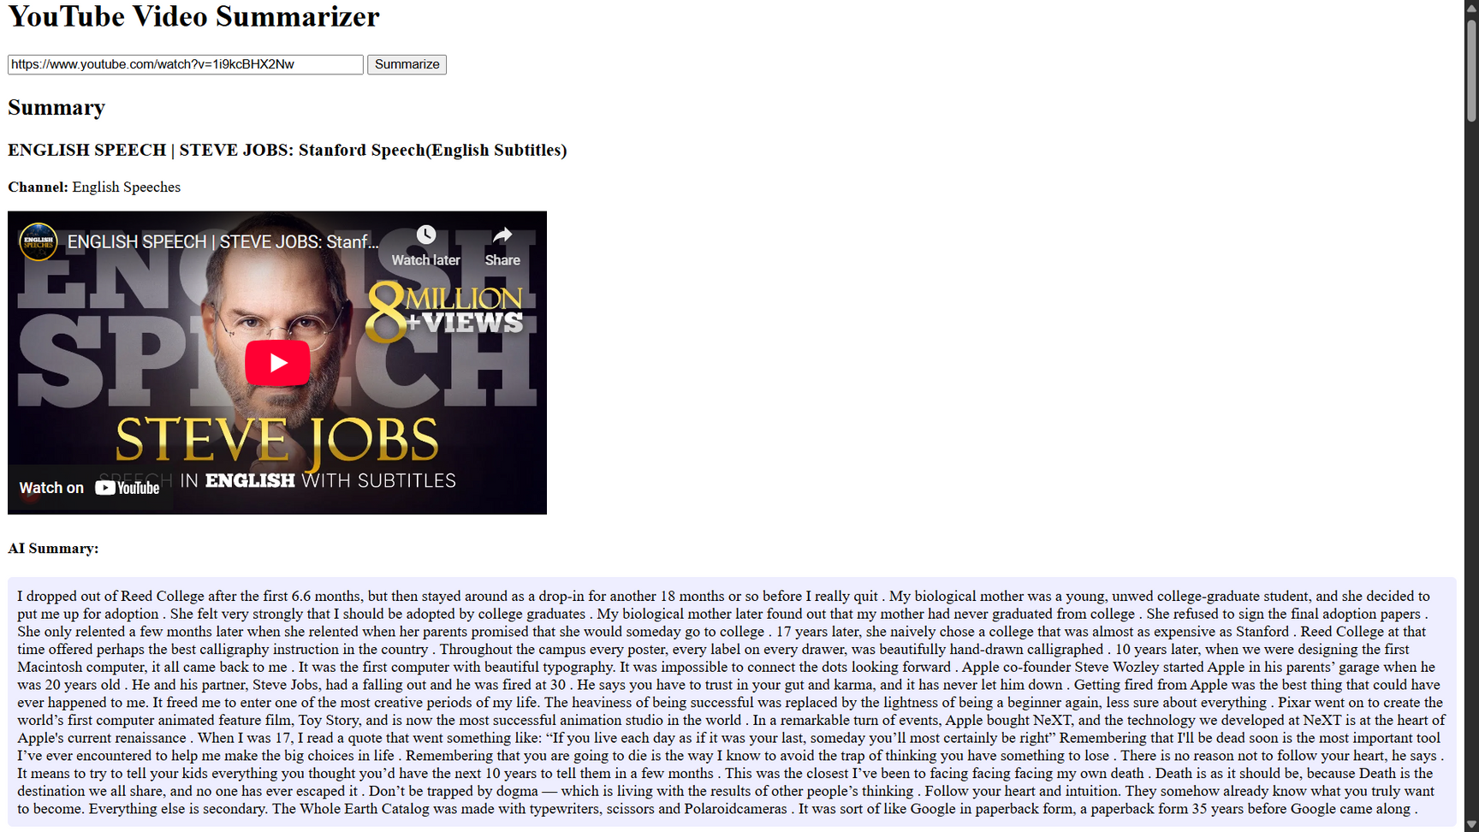
X
RESULTS
Website
12
2

Slide 20
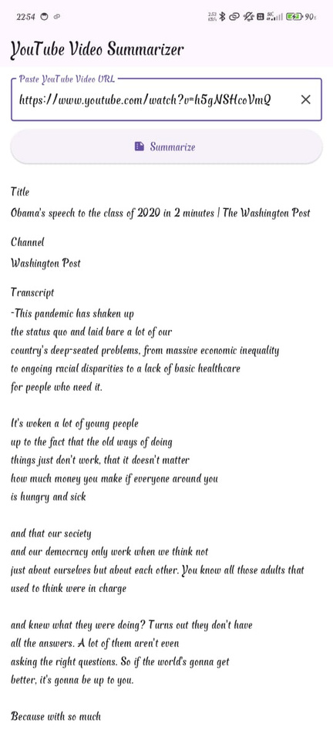
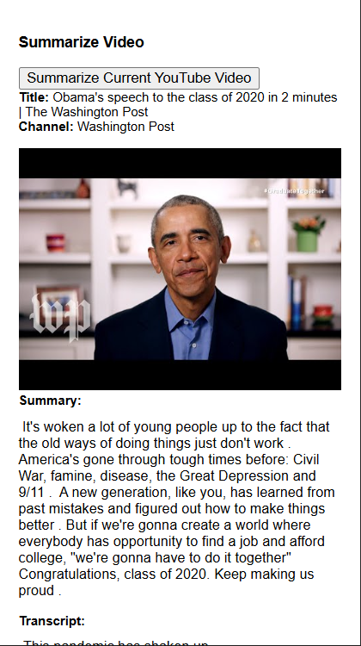
X
RESULTS
App
Extension
12
2

Slide 21
XI
CONCLUSION
The proposed Android-based Video Summarization Application offers an intelligent and efficient solution for extracting meaningful content from videos. By integrating Automatic Speech Recognition (ASR), Natural Language Processing (NLP), and Machine Learning (ML), the app provides accurate transcriptions and generates structured summaries and detailed descriptions.
13
2

Slide 22
XII
REFERENCES
ScreenApp- https://screenapp.io/features/ai-summarizer
Bossard, A., Généreux, M., Poibeau, T.: Cbseas, a summarization system – integration of opinion mining techniques to summarize blogs. In: Proceedings of the 12th Meeting of the European Association for Computational Linguistics (system demonstration), EACL ’09, Athens. Association for Computational Linguistics, Stroudsburg (2009).
Flask Reference https://github.com/AnujK2901/yt-sum-flask
Creating Chrome extension https://medium.com/coding-in-simple-english/how-to-createchrome-extension-7dd396e884ef
13
2

Slide 23
JNTUH UNIVERSITY COLLEGE OF ENGINEERING SULTHANPUR
Thank you!

